Slide 1
How it’s made

Slide 2
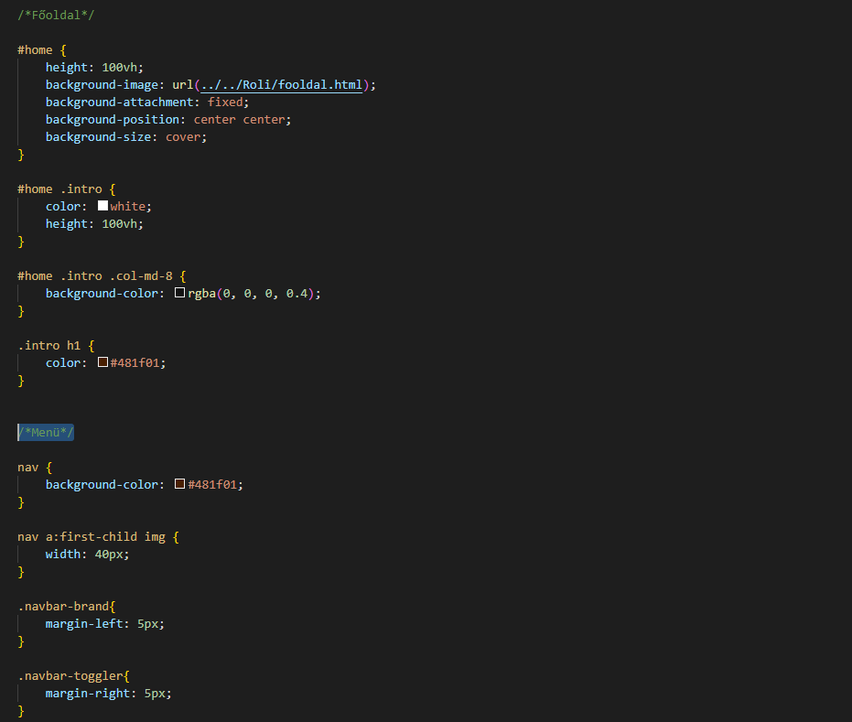
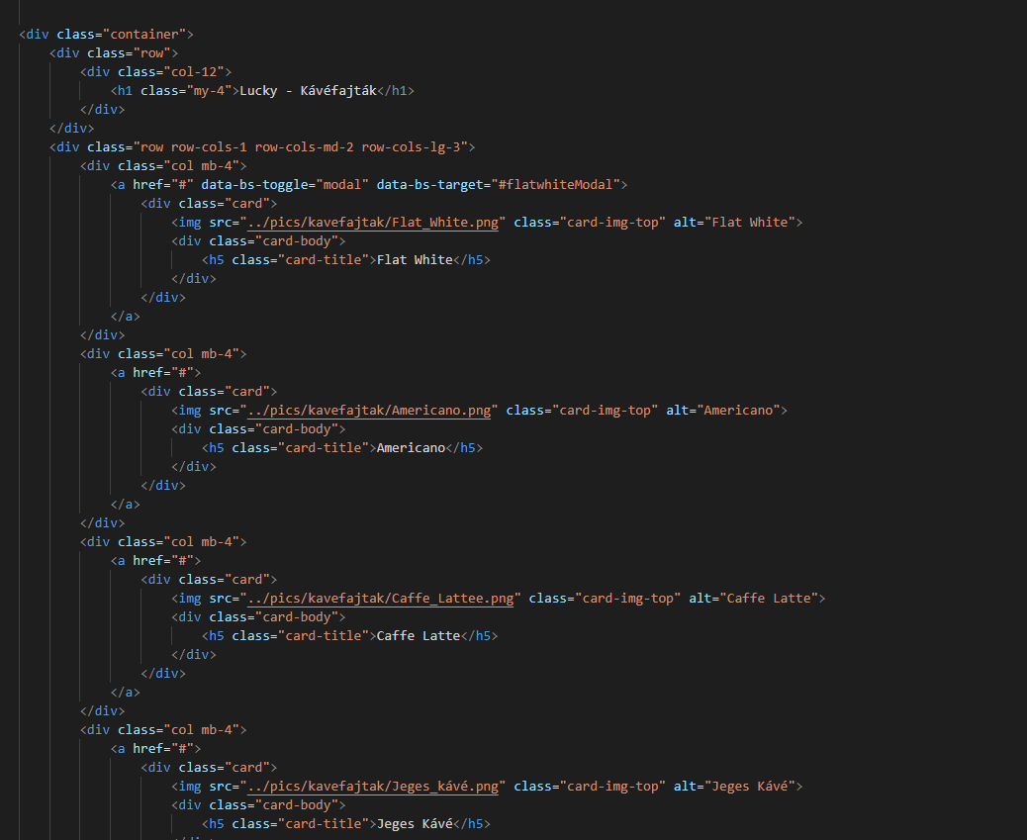
Expectations
Modern
Up to date with HTML5, CSS3 standards
Responsive

Slide 3
Workflow

Slide 4
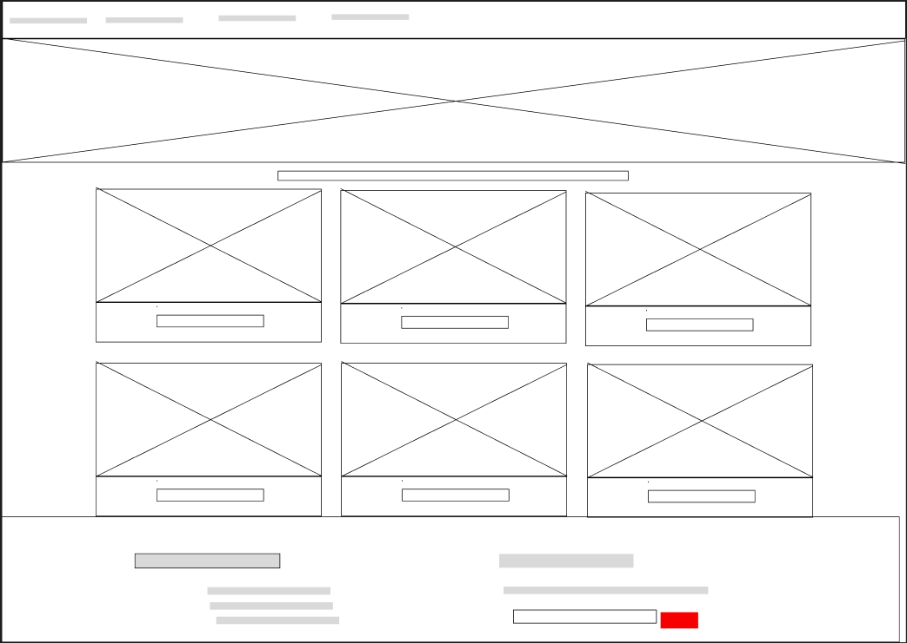
Wireframe

Slide 5
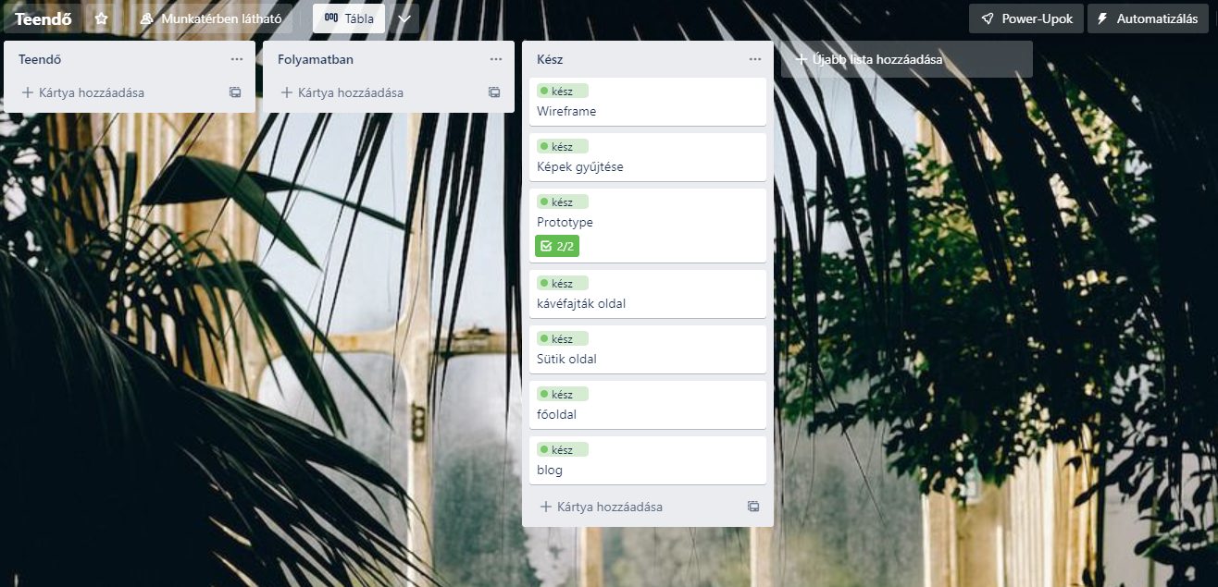
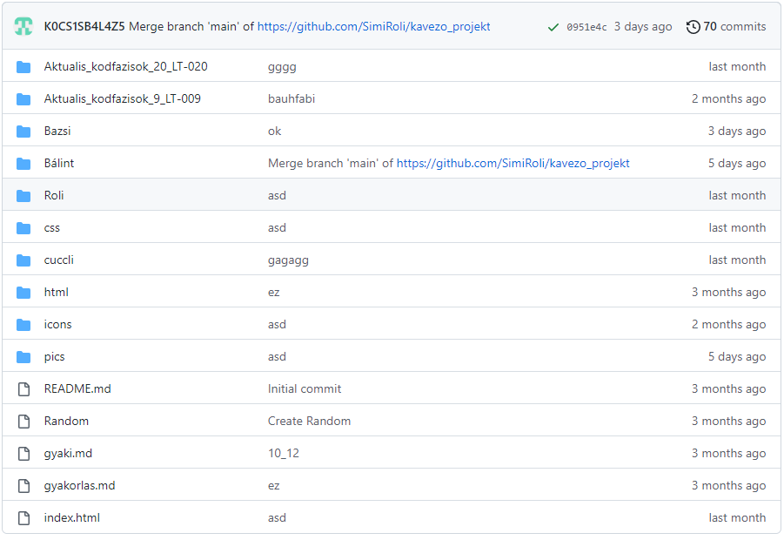
Track of progress

Slide 6
theme

Slide 7
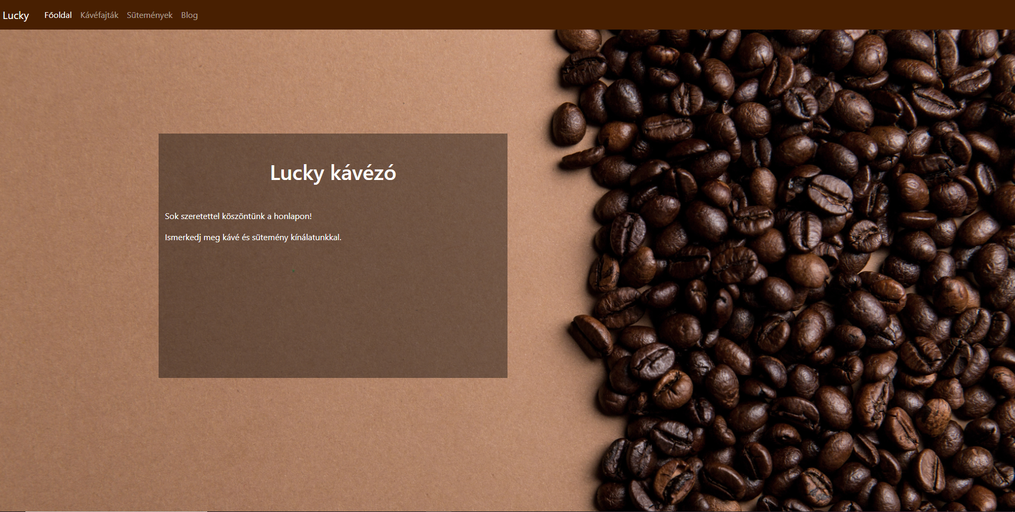

Slide 8
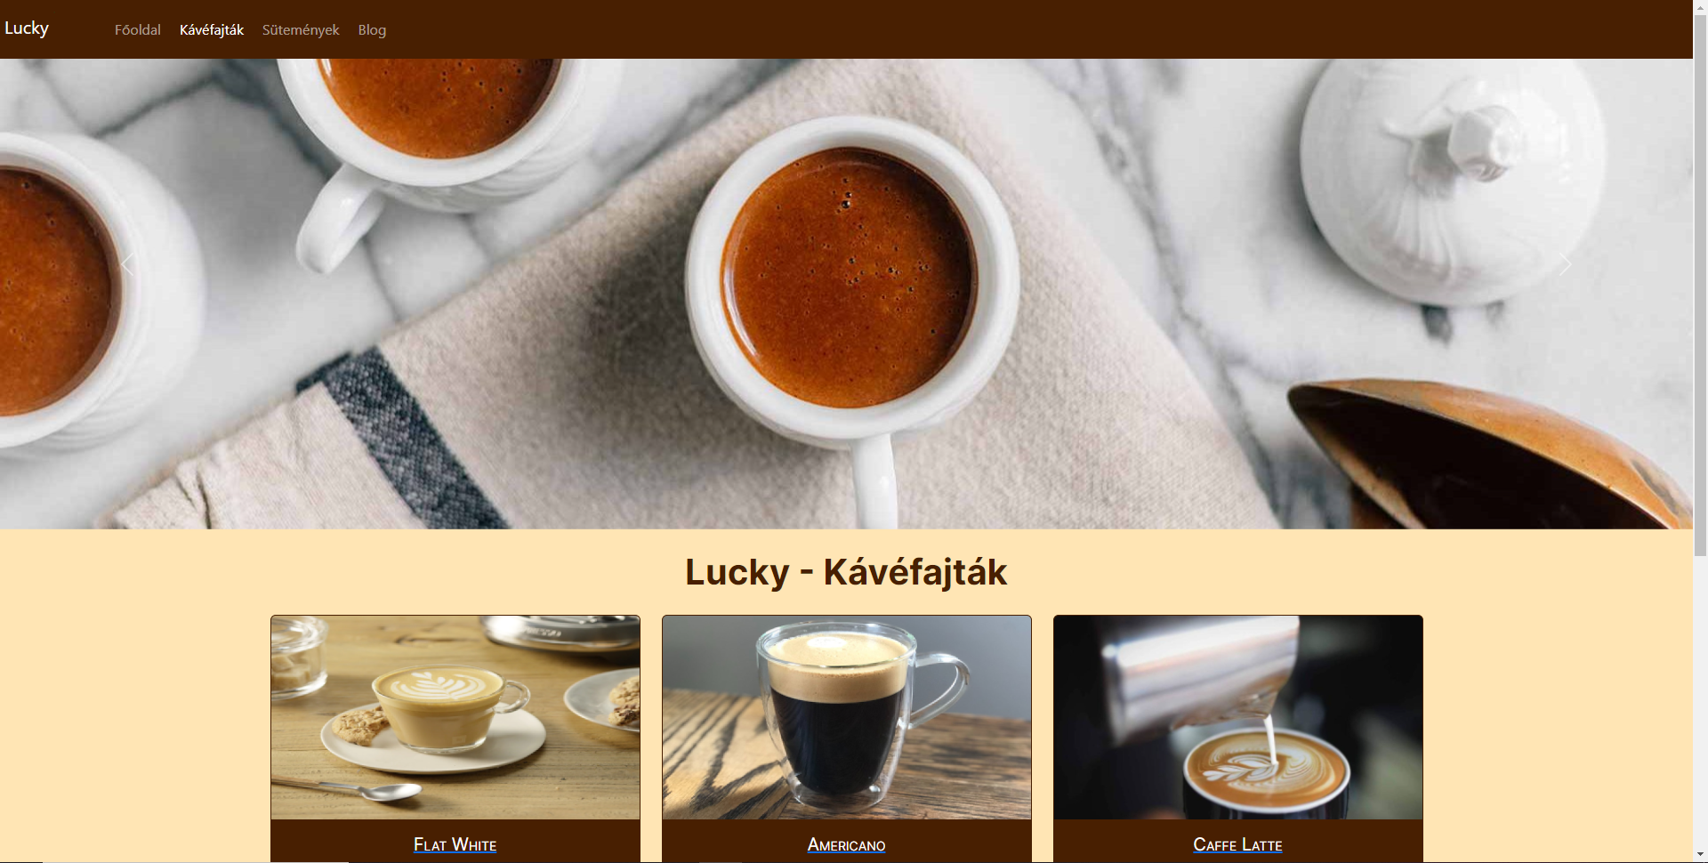

Slide 9
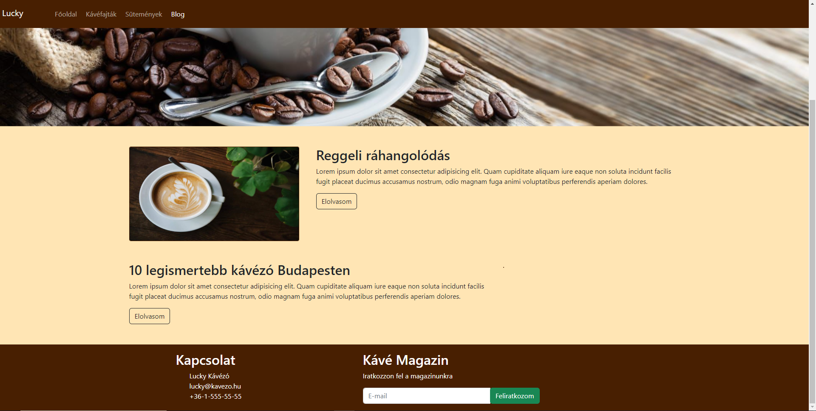

Slide 10
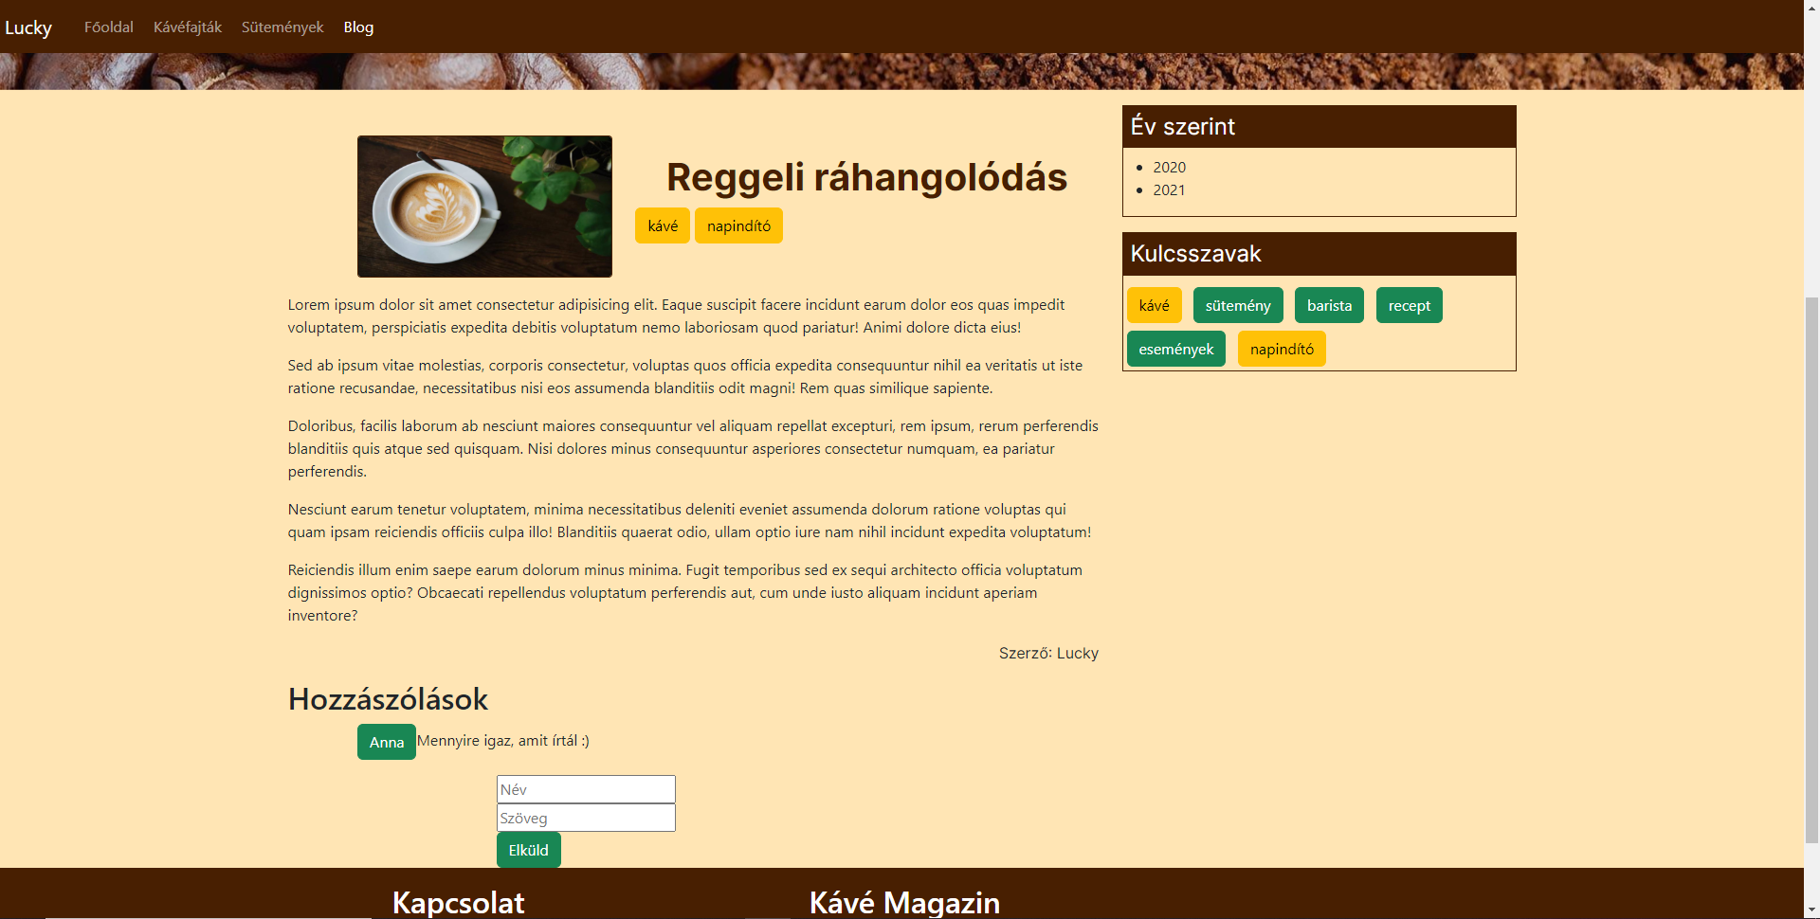

Slide 11
Thank you for your attention and for choosing us!

